Slide 1
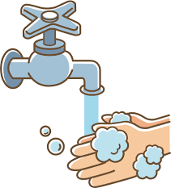
Putting on a face mask
Wash your hands with handgel or soap and water for 20 seconds before touching the mask
1

Slide 2
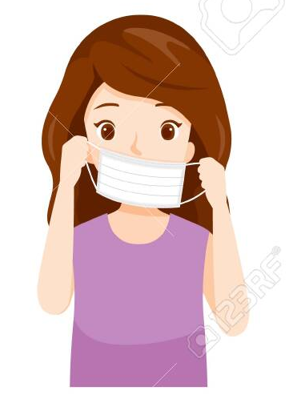
Putting on a face mask
Hold the mask by the elastic loops, place it over your mouth and tuck the elastic loops behind your ears
2

Slide 3

Putting on a face mask
Make sure your mouth and nose are covered
3

Slide 4
Putting on a face mask
Wash your hands with handgel or soap and water for 20 seconds after putting your mask on
4

Slide 5

Putting on a face mask
Do not touch the front of the mask while you are wearing it
5

Slide 6
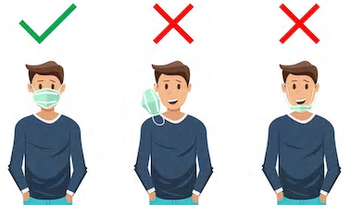
Putting on a face mask
6
Wear your mask sensibly at all times

Slide 7
Taking off a face mask
Wash your hands with handgel or soap and water for 20 seconds before touching the mask
1

Slide 8
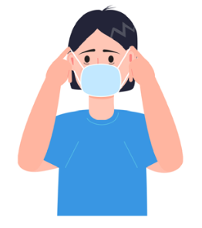
Taking off a face mask
Take the mask off using the elastic loops
- do not touch the front of the mask
2

Slide 9
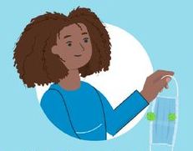
Taking off a face mask
Keep the mask away from you and do not put it down on anything
3

Slide 10
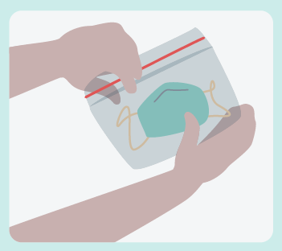
Taking off a face mask
If the mask is reusable – put it in a sealed bag and take it home to be washed
4

Slide 11
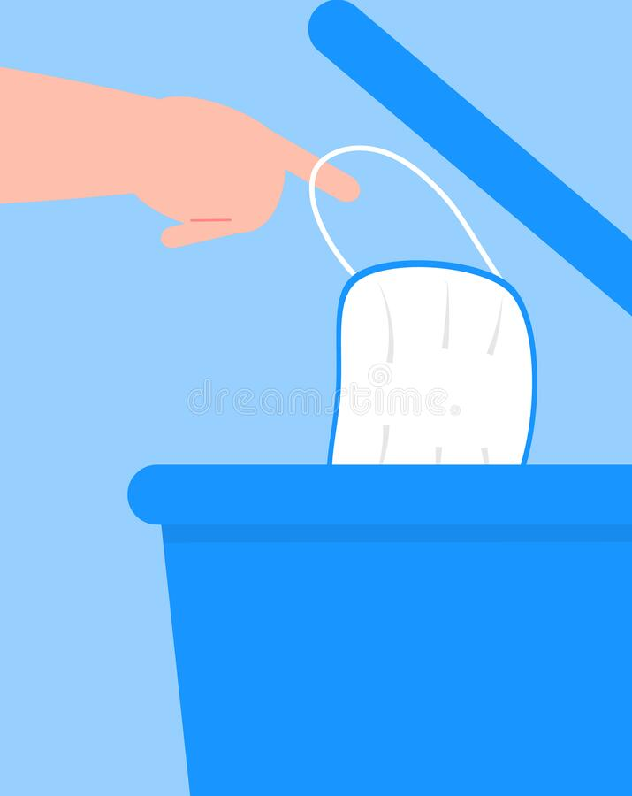
Taking off a face mask
If the mask is not reusable – put it in a lidded bin
5

Slide 12
Taking off a face mask
Wash your hands with handgel or soap and water for 20 seconds after taking your mask off
6

